Slide 1
CLIENT/SERVER COMPUTING
Client/Server is a term used to describe a computing model for the development of computerized systems. This model is based on the distribution of functions between processors: servers and clients. A client is any process that requests specific services from server processes. A server is a process that provides requested services for clients. Client and server processes can reside in the same computer or in different computers connected by a network.

Slide 2
Client/Server Architecture
The client/Server architecture is based on hardware and software components that interacts to form a system. This system includes three main components:
•Clients
•Servers
•Communication middleware

Slide 3
Client/Server Architecture…
Client:
The client is any computer process that requests services from the server. The client request is based on code which require certain services from the server.

Slide 4
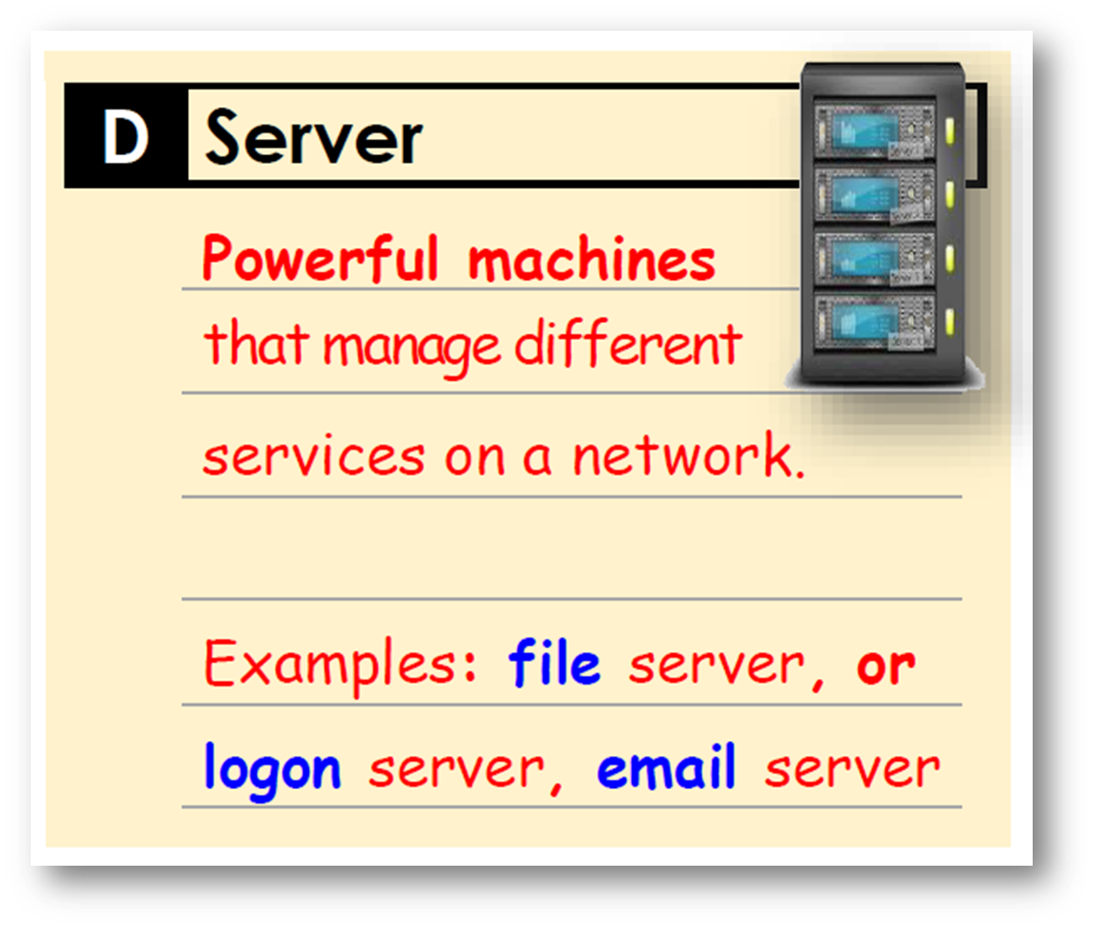
Client/Server Architecture…
Server:
The server is any computer process providing services to the clients. The server application reflecting the fact that the server process provide the background services.

Slide 5
Client/Server Architecture…
Communication middleware:
It is any computer process(es) through which clients and servers communicate. The communication middleware, also known as middleware or the communications layers, is made up of several layers of software that aid the transmission of data and control information between clients and servers.

Slide 6
Client/Server Architecture…
How Components Interact
Client process sends SQL request through communication middleware.
Communication middleware routes SQL request to database server process
Database server process receives request, validates it, and execute it.
Client Process
SQL
Communication Middleware Network
SQL
Database Server
Data
Data

Slide 7
CLIENT/SERVER PRINCIPLES
•Hardware Independence
•Software Independence
•Operating System
•Network System
•Applications
•Open access to services

Slide 8
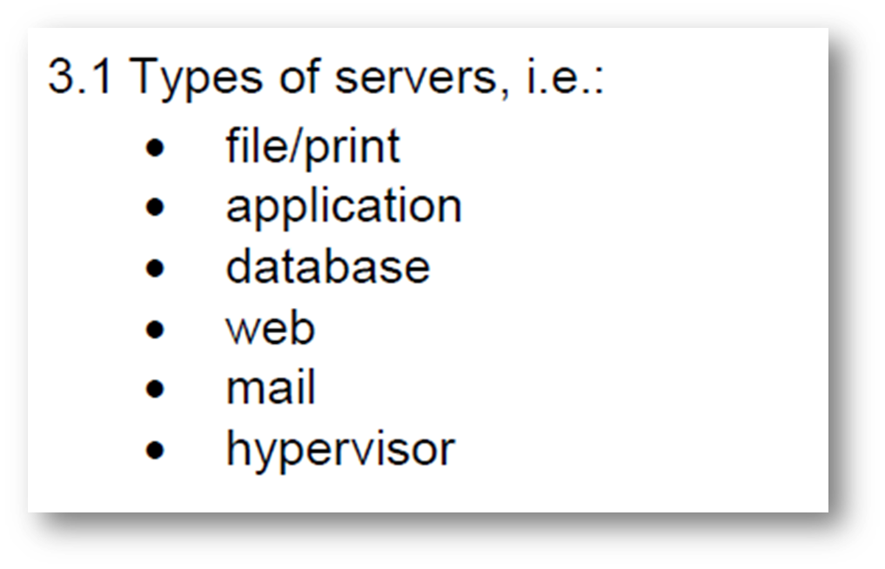
Types of Servers

Slide 9
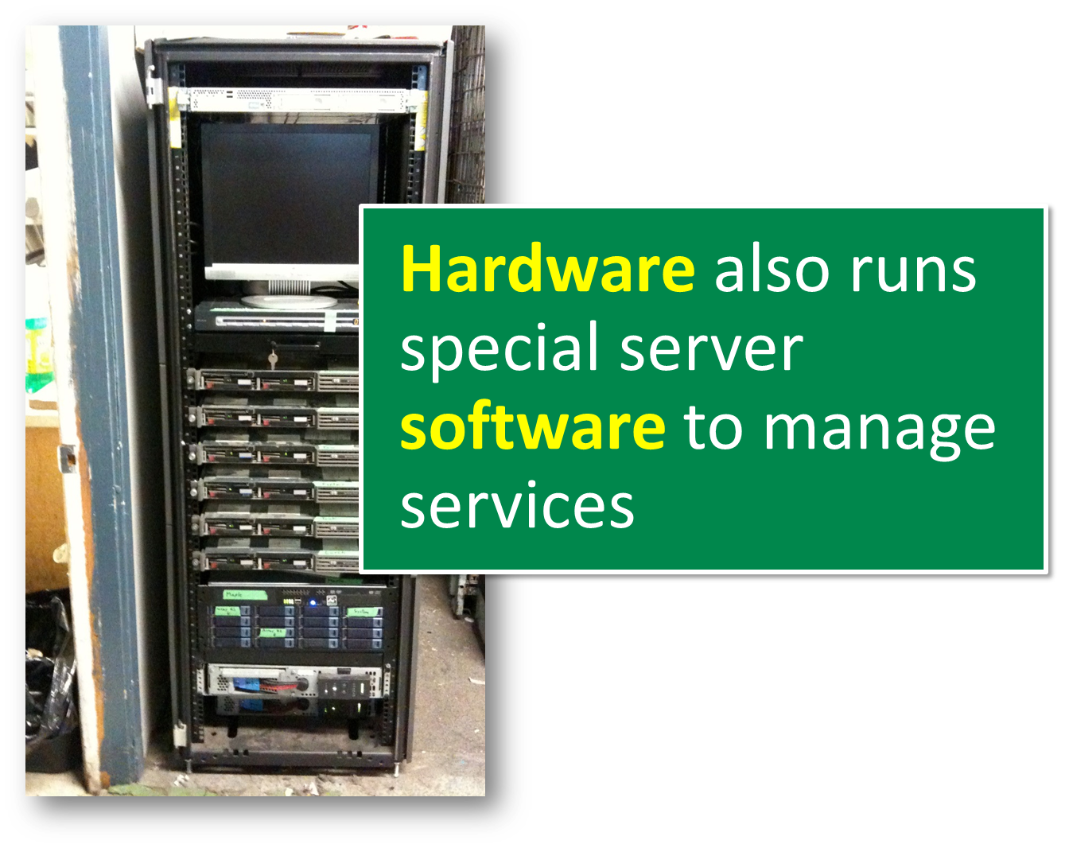

Slide 10
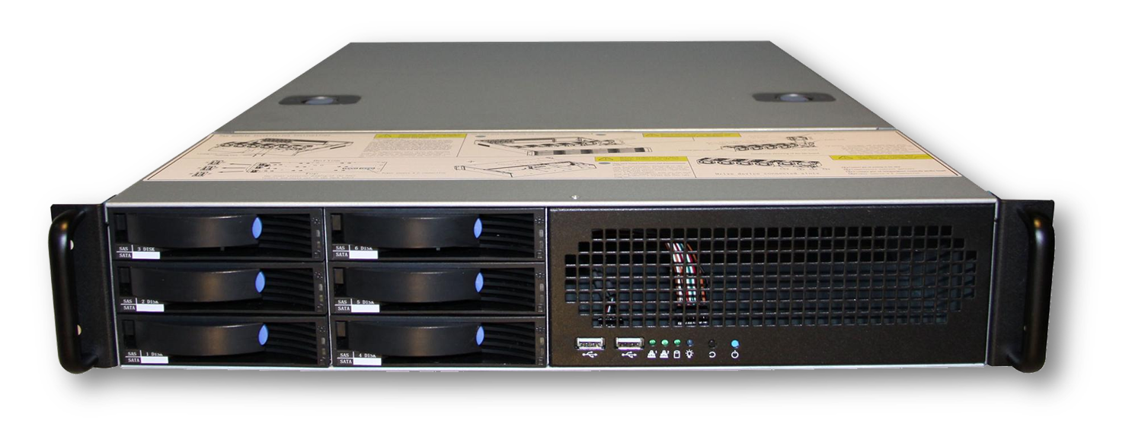
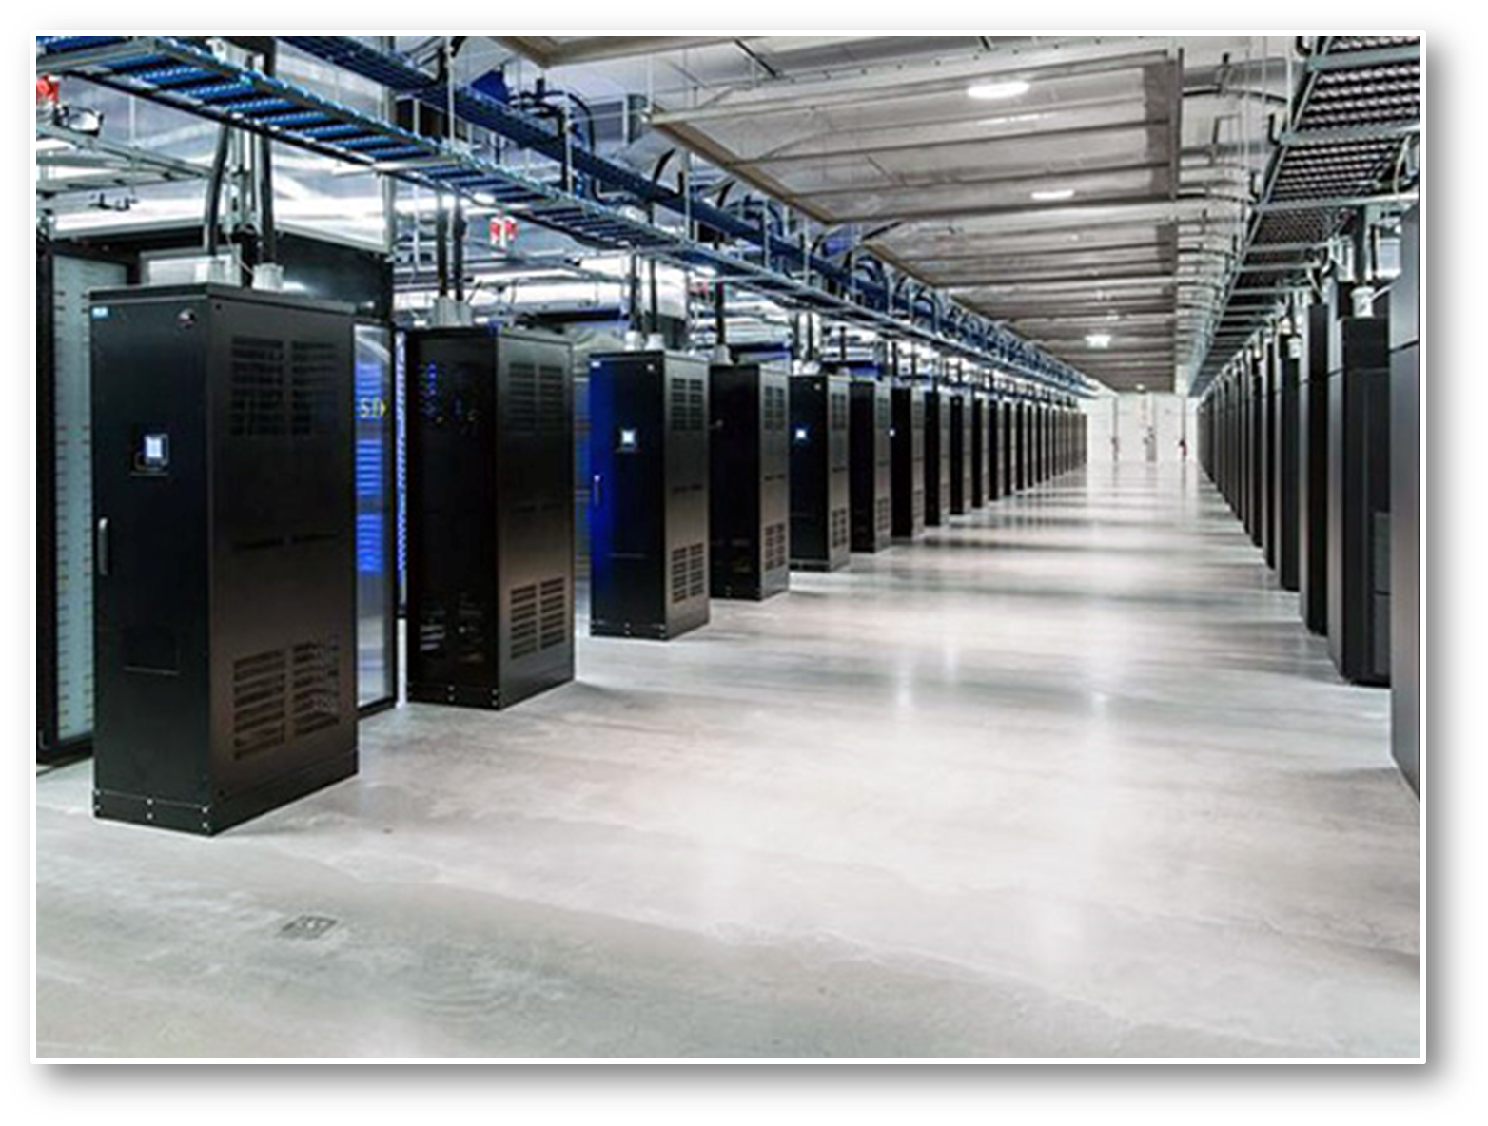
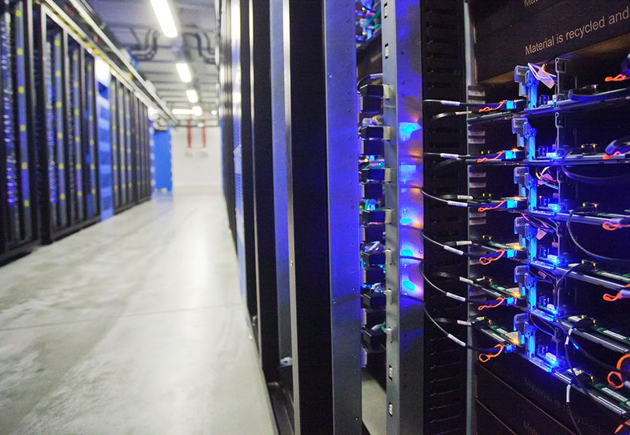

Slide 11



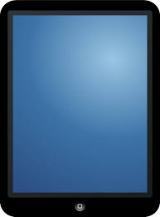
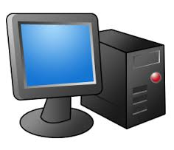
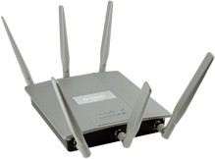
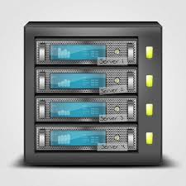
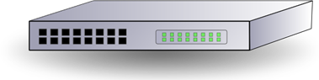
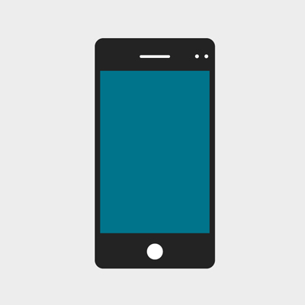

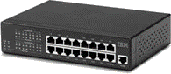

Data Packets
Client Devices
Network Server
Wireless Access Point
Switch
Hub
Local Area Network (LAN)

Slide 12

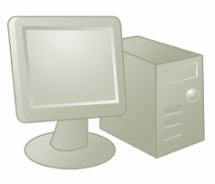
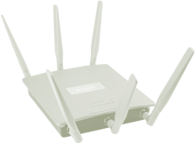
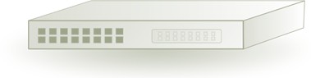
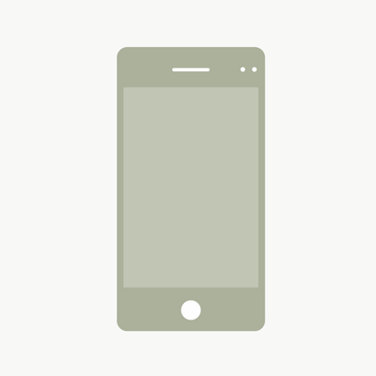
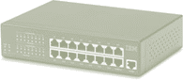
Network Server

Slide 13
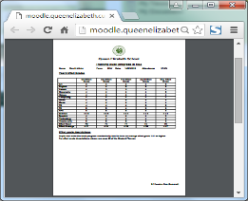
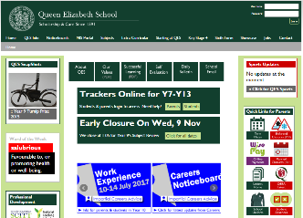
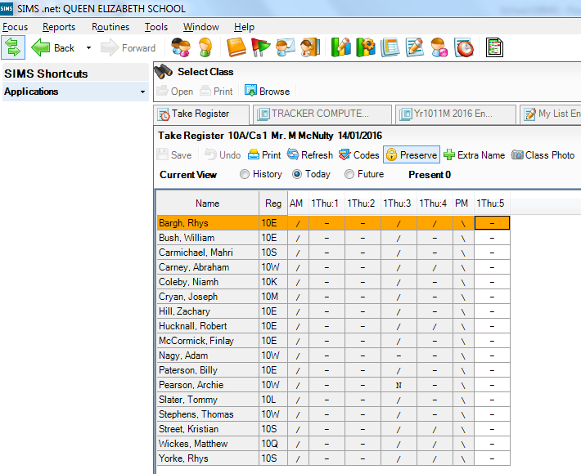

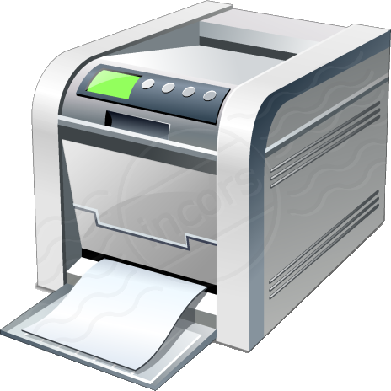
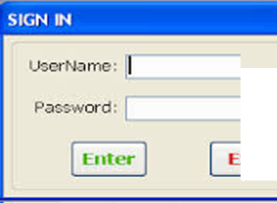
Web Server
Database Server
Network Server
File Server
Print Server

Slide 14
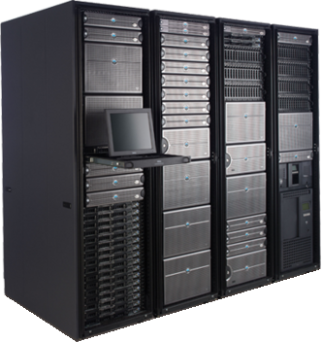
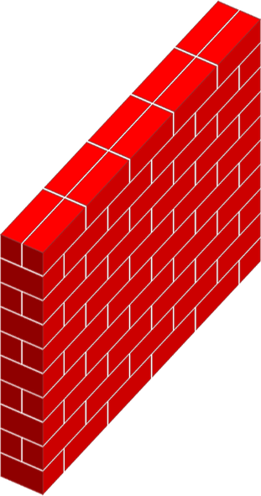
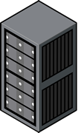
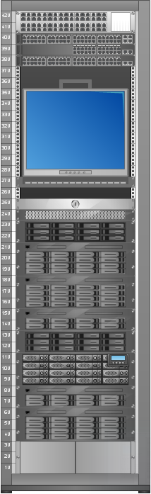
(eg the Internet)
Local Area Network
Wide Area Network
Server Farm
Mail Server
Firewall
Web Server
Client Devices

Slide 15

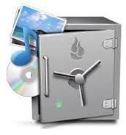
File Server
Stores large number of files for an organisation
Also controls security, such as access rights to files
Finally, handles backups in case of accident or disaster

Slide 16
Print Server
Manages queue of docs for printing
So shares load of print requests across available devices
Controls access to printers for users & routes docs to devices

Slide 17
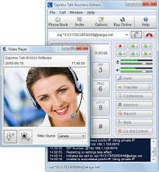
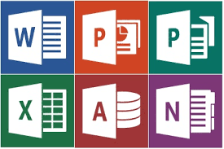
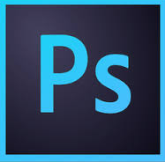
Application Server
Installs, updates & controls access to programs
Includes applications such as word processor or email
Application runs through the main server, and client has the ability to execute it with support of frameworks.

Slide 18
Database Server
Manages security & updates to large databases
For example in a school, security means controlling access to staff
So teachers update registers & office staff update financial data

Slide 19
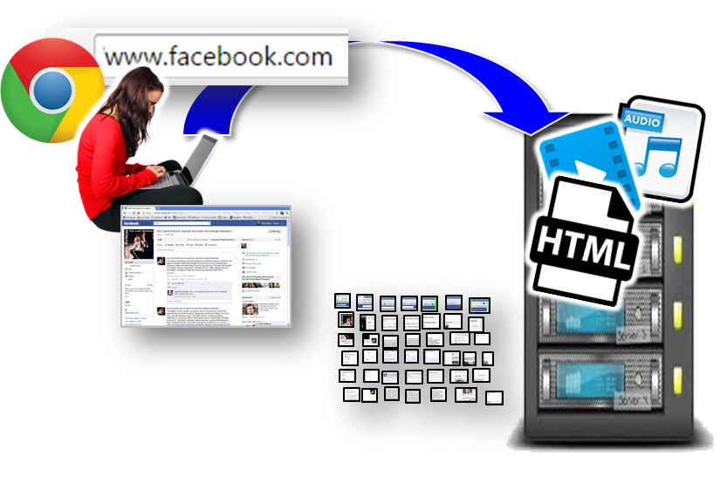
Web Server
Stores all files for a website
Sends them when user’s browser sends a request for the website
Web server then sends the site’s files using the HTTP protocol

Slide 20
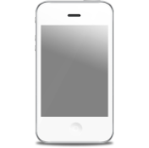

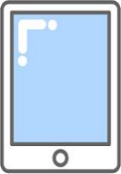
Mail Server
Stores & forwards emails like an electronic post office
Data traffic controlled by protocols, eg SMTP (send) & POP (receive)
But email traffic is not immediate like instant messaging or ‘chat’

